Slide 1
DataBase Connectivity
Python Database API supports a wide range of database servers such as
GadFly
mSQL
MySQL
PostgreSQL
Microsoft SQL Server 2000
Informix
Interbase
Oracle
Sybase

Slide 2
Database Connection
There are the following steps to connect a python application to mysql database.
Import mysql.connector module
Create the connection object.
Create the cursor object
Execute the query
Cursor class is an instance using which you can invoke methods that execute SQLite statements, fetch data from the result sets of the queries.

Slide 3
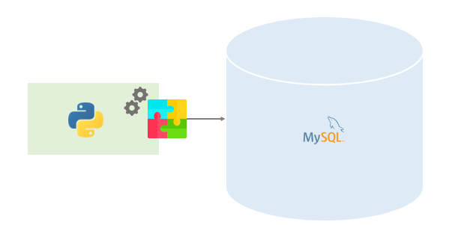
MySQL Python connector & its installation
Introduction: To access the MySQL database from Python, you need a database driver. MySQL Connector/Python is a standardized database driver provided by MySQL.
installing mysql-connector-python 8.0.19
pip install mysql-connector-python
uninstall current mysql-connector-python
pip uninstall mysql-connector-python

Slide 4
Step-1 & 2
import module for database
Create the connection object.
Connector/Python provides a connect() call used to establish connections to the MySQL server.
A connection with the MySQL server can be established using either the mysql.connector.connect() function or the mysql.connector.MySQLConnection() class
If a connection is established with the data source, then a Connection Object is returned and saved into db for further use, otherwise db is set to None.
db object is used to create a cursor object, which in turn is used to execute SQL queries
Finally, before coming out, it ensures that database connection is closed and resources are released.

Slide 5
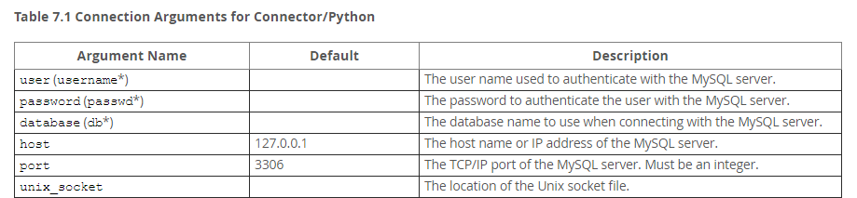
Few Connection Arguments for Connector/Python
For other arguments refer below link:
https://dev.mysql.com/doc/connector-python/en/connector-python-connectargs.html

Slide 6
Connection methods
Connection objects should respond to the following methods.
.close() Close the connection now (rather than whenever .__del__() is called).
.commit() Commit any pending transaction to the database. Note that if the database supports an auto-commit feature, this must be initially off. An interface method may be provided to turn it back on. Database modules that do not support transactions should implement this method with void functionality.
Note: Autocommit is disabled by default when connecting through Connector/Python. This can be enabled using the autocommit connection parameter.
.rollback()This method is optional since not all databases provide transaction support. In case a database does provide transactions this method causes the database to roll back to the start of any pending transaction. Closing a connection without committing the changes first will cause an implicit rollback to be performed.
.cursor()Return a new Cursor Object using the connection. If the database does not provide a direct cursor concept, the module will have to emulate cursors using other means to the extent needed by this specification.

Slide 7
Step-3 & 4
Database connection object uses cursor() to create a cursor object, which in turn is used to execute SQL queries.
Example:
import mysql.connector
db = mysql.connector.connect( host="localhost", user="yourusername", passwd="yourpassword", database="mydatabase" )
mycursor = db.cursor() mycursor.execute("CREATE TABLE customers (name VARCHAR(255), address VARCHAR(255))")

Slide 8
Cursor Object methods
.close():Close the cursor now (rather than whenever __del__ is called).The cursor will be unusable from this point forward; an Error (or subclass) exception will be raised if any operation is attempted with the cursor.
.execute(operation [, parameters])Prepare and execute a database operation (query or command).
.executemany( operation, seq_of_parameters )Prepare a database operation (query or command) and then execute it against all parameter sequences or mappings found in the sequence seq_of_parameters.
.fetchone()Fetch the next row of a query result set, returning a single sequence, or None when no more data is available. An Error (or subclass) exception is raised if the previous call to .execute*() did not produce any result set or no call was issued yet.
.fetchmany([size=cursor.arraysize])Fetch the next set of rows of a query result, returning a sequence of sequences (e.g. a list of tuples). An empty sequence is returned when no more rows are available.
.fetchall()Fetch all (remaining) rows of a query result, returning them as a sequence of sequences (e.g. a list of tuples). Note that the cursor's arraysize attribute can affect the performance of this operation.
.arraysizeThis read/write attribute specifies the number of rows to fetch at a time with .fetchmany(). It defaults to 1 meaning to fetch a single row at a time.

Slide 9
Error Handling
When an exception is thrown you have access to error code, SQLSTATE and error message in form of errno, sqlstate and msg attributes of the exception object.
The mysql.connector.errors module defines exception classes for errors and warnings raised by MySQL Connector/Python.
Most classes defined in this module are available when you import mysql.connector.
mysql.connector.errors.Error exception is the base class for all other exceptions in the errors module. It can be used to catch all errors in a single except statement.
Eg:

Slide 10
What is errno, sqlstate and msg descriptor
Errors and warnings in MySQL contains three pieces of information
mysql> select * from earth;
ERROR 1146 (42S02): Table 'world.earth' doesn't exist
A unique MySQL specific error code (1146) that is not portable to other databases.
A 5 character code (42S02) called SQLSTATE which is used to indicate success or failure of the operation. The SQLSTATE is portable across other databases. It consists of two parts: the first two character represents SQL error class and the next three represents subclass. Each class can belong to one of the following four categories.
Success (class 00)
Warning (class 01)
No Data (class 02)
Exception (all the others 07-HZ)
A textual description of the error.

Slide 11
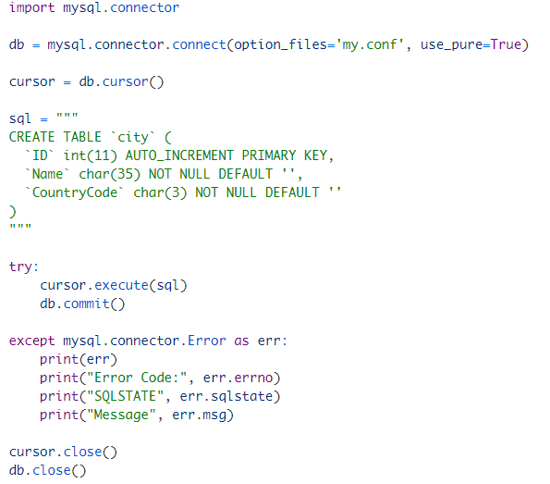


Slide 12
Hierarchy of the exception classes:
The mysql.connector.errors.Error base class is further subclassed into the following three class:
1. DatabaseError: This exception is raised for errors related to the database. It can catch a variety of errors like problem in data processing, error in SQL syntax, MySQL internal problems etc. If a connection is made and a problem arises then DatabaseError will catch it.
There are 6 types of DatabaseError:
DataError
InternalError
IntegrityError
OperationalError
NotSupportedError
ProgrammingError
2. InterfaceError: This exception is raised for errors related to the interface (in our case interface is MySQL Connector/Python) rather than the database itself.
3. PoolError: It is raised for errors related to connection pooling.
In software engineering, a connection pool is a cache of database connections maintained so that the connections can be reused when future requests to the database are required. Connection pools are used to enhance the performance of executing commands on a database.

Slide 13
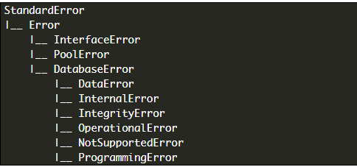
Figure shows hierarchy of the exception classes

Slide 14
Transaction in a Database
The database transaction represents a single unit of work.
A transaction is a way to execute a set of SQL statements such that either all of the statements execute successfully or none at all
If any one of the statements in a transaction fails, then the database is rolled back to the point at which transaction began.
For example, take an example of Bank amount transfer Transaction, it involves two tasks with in the same transaction
Withdrawal of money from account A
Deposit Money to Account B
If the first Task is executed successfully, but second failed, in this case, we need to re-deposit money back to account A. To manage such cases we need transaction management.

Slide 15
ACID Properties of Transaction
Atomicity means all or nothing. Either all transactions are successful or none. You can group SQL statements as one logical unit, and if any query fails, the whole transaction fails.
Consistency ensures that the database remains in a consistent state after performing a transaction.
Isolation ensures that transaction is isolated from other transaction.
Durability means once a transaction has been committed, it persists in the database irrespective of power loss, error or restart system.

Slide 16
Transaction Processing
The Python DB-API abstraction provides transaction processing control through connection object methods.
The DB-API specification indicates that database connections should begin with auto-commit mode disabled.
Therefore, when you open a connection to the database server, auto-commit mode is disabled by default, which implicitly begins a transaction. End each transaction with either commit() or rollback().
The commit() call occurs within a try statement, and the rollback() occurs within the except clause to cancel the transaction if an error occurs:

Slide 17
Methods to manage MySQL database transactions in Python
MySQLConnection.commit() Method
This method sends a COMMIT statement to the MySQL server, committing the current transaction. Since by default Connector/Python does not autocommit, it is important to call this method after every transaction that modifies data for tables that use transactional storage engines.
cursor.execute("INSERT INTO employees (first_name) VALUES (%s)", ('Jane')) cnx.commit()
MySQLConnection.rollback() Method
This method sends a ROLLBACK statement to the MySQL server, undoing all data changes from the current transaction. By default, Connector/Python does not autocommit, so it is possible to cancel transactions when using transactional storage engines such as InnoDB.
cursor.execute("INSERT INTO employees (first_name) VALUES (%s)", ('Jane'))
cnx.rollback()
MySQLConnection.autocommit value can be assigned as True or False to enable or disable the auto-commit feature of MySQL. By default its value false or equals to 0

Slide 18
Use Commit and Rollback to Manage MySQL Transactions in Python
To manage MySQL transactions in python follow these steps: –
Create MySQL database connections in python.
Prepare the SQL queries that you want to run as a part of a transaction. For example for bank transfer, we can combine two SQL queries(withdrawal money and deposit money query) in a single transaction.
Set an auto-commit property of MySQL connection to false. By default also it is false.
Execute all queries one by one using cursor.execute()
If all queries execute successfully commit the changes to the database
If one of the queries failed to execute rollback all the changes.
Catch any SQL exceptions that may occur during this process
Close the cursor object and MySQL database connection

Slide 19
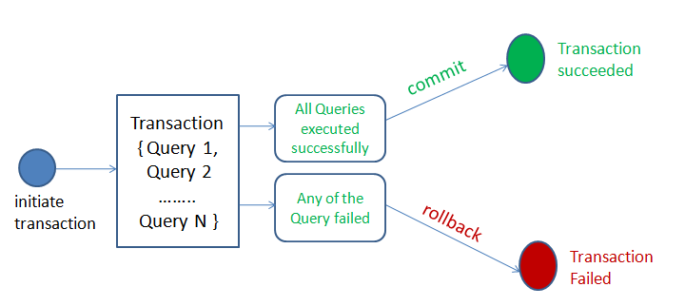
MySQL database transactions in Python

Slide 20
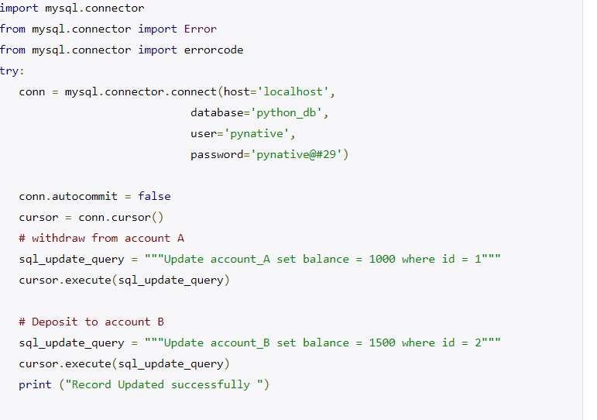
Python example to manage MySQL transactions using commit and rollback

Slide 21
